Slide 1
Internet Structure and Authorities

Slide 2
What is ?
ICANN, IANA, RIR
NIR, LIR, ISPs
AS
LANs, Subnets
IPv4, IPv6
Subnetting, Supernetting

Slide 3
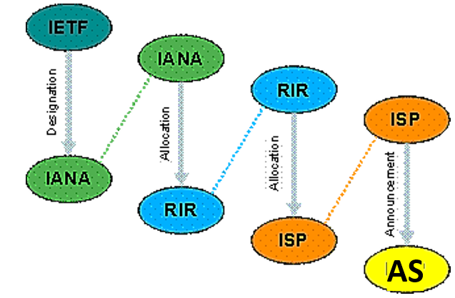
What is ICANN, IANA, RIR? What are NIR, LIR, ISPs, AS, LANs, Subnets?

Slide 4
ICANN, IANA
The Internet Corporation for Assigned Names and Numbers (ICANN) is a nonprofit organization, organized from the Secretary of State of the State of California in the U.S. that is responsible for coordinating the maintenance and methodologies of several databases, with unique identifiers, related to the namespaces of the Internet.
The Internet Assigned Numbers Authority (IANA) is a department of ICANN, a nonprofit private American corporation that oversees global IP address allocation, autonomous system number allocation, root zone management in the Domain Name System (DNS).
IANA delegates Internet resources to the Regional Internet Registry (RIRs) who, in turn, follow their regional policies to delegate resources to their customers, which include Internet service providers (ISPs) and end-user organizations.
负责协调与Internet名称空间相关的多个数据库的维护和方法，具有惟一的标识符。
IANA是ICANN的一个部门，负责监督全球IP地址分配、自治系统号码分配、域名系统(DNS)根区域管理。
IANA将互联网资源委托给区域互联网登记处RIRs，而RIRs又遵循区域政策将资源委托给他们的客户，包括互联网服务提供商(isp)和最终用户组织。
Notes:
Image: http://farm8.staticflickr.com/7108/7523337830_860064e149_o.jpg

Slide 5
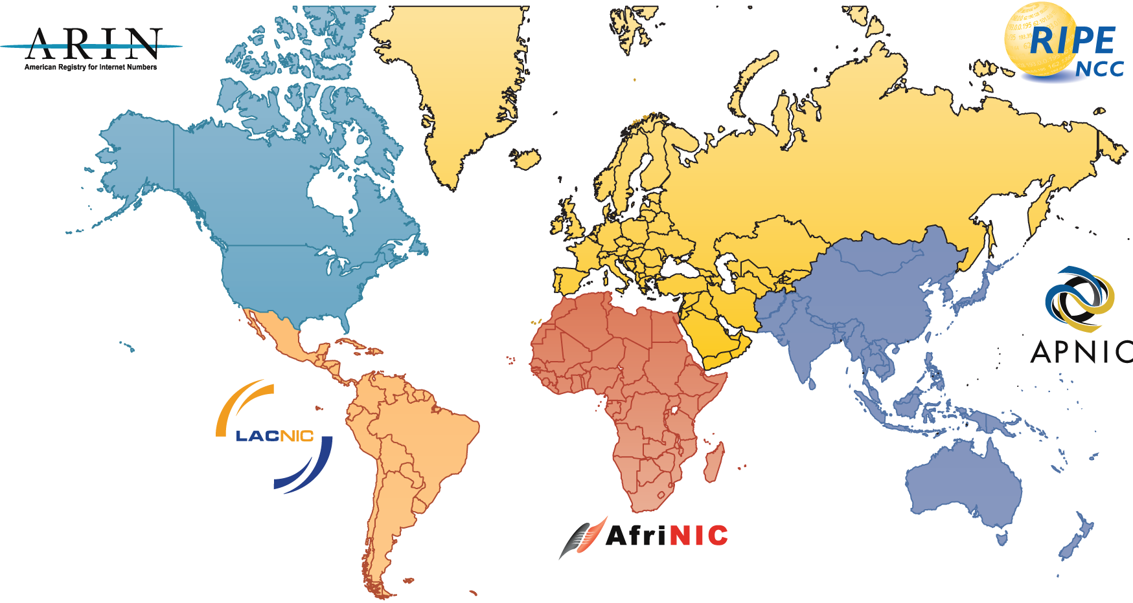
RIRs

Slide 6
RIR (Regional Internet Registry)
The Regional Internet Registry system evolved over time, eventually dividing the world into five RIRs:
African Network Information Center (AFRINIC) for Africa
American Registry for Internet Numbers (ARIN) for the United States, Canada, several parts of the Caribbean region, and Antarctica.
Asia-Pacific Network Information Centre (APNIC) for Asia, Australia, New Zealand, and neighboring countries
Latin America and Caribbean Network Information Centre (LACNIC) for Latin America and parts of the Caribbean region
Réseaux IP Européens Network Coordination Centre (RIPE NCC) for Europe, Russia, the Middle East, and Central Asia
Notes:
Image: http://farm8.staticflickr.com/7108/7523337830_860064e149_o.jpg

Slide 7
RIR->NIR->LIR->ISP->AS
A regional Internet registry (RIR) is an organization that manages the allocation and registration of Internet number resources within a particular region of the world. Internet number resources include IP addresses and autonomous system (AS) numbers.
Regional Internet Registries (RIRs) are established and authorized by respective regional communities, and recognized by the IANA to serve and represent large geographical regions. The primary role of RIRs is to manage and distribute public Internet address space within their respective regions.
区域互联网注册机构(RIR)是一个组织，负责管理世界上某一特定区域内互联网号码资源的分配和注册。
Internet资源包括IP地址（包含IPv4和IPv6）和使用在BGP路由中的自治系统号（Autonomous System number）
RIRs由各自的区域社区建立和授权，并得到IANA的承认，以服务和代表大的地理区域。
Notes:
Image: http://farm8.staticflickr.com/7108/7523337830_860064e149_o.jpg

Slide 8
RIR->NIR->LIR->ISP->AS
A National Internet Registry (or NIR) is an organization under the umbrella of a Regional Internet Registry with the task of coordinating IP address allocations and other Internet resource management functions at a national level within a country or economic unit.
For example, The following NIRs are currently operating in the APNIC region:
APJII (Asosiasi Penyelenggara Jasa Internet Indonesia), Indonesian ISP Association
CNNIC, China Internet Network Information Center
JPNIC, Japan Network Information Center
KRNIC, National Internet Development Agency of Korea
SGNIC, Singapore Network Information Centre
TWNIC, Taiwan Network Information Center
VrNNIC, Vietnam Internet Network Information Center
NIR是RIR下的一个组织，其任务是在一个国家或经济单位内协调国家一级的IP地址分配和其他互联网资源管理职能。
Notes:
Image: http://farm8.staticflickr.com/7108/7523337830_860064e149_o.jpg

Slide 9
RIR->NIR->LIR->ISP->AS
A local Internet registry (LIR) is an organization that has been allocated a block of IP addresses by a regional Internet registry (RIR), and that assigns most parts of this block to its own customers.
It primarily assigns address space to the users of the network services that it provides. LIRs are generally Internet Service Providers (ISPs), whose customers are primarily end users and possibly other ISPs. Membership in an RIR is required to become an LIR.
LIR是一个由RIR分配IP地址块的组织，它将该IP地址块的大部分分配给自己的客户。
它主要为其提供的网络服务的用户分配地址空间。lir通常是Internet服务提供商(isp)，其客户主要是最终用户，也可能是其他isp。RIR的成员资格需要成为LIR。
Notes:
Image: http://farm8.staticflickr.com/7108/7523337830_860064e149_o.jpg

Slide 10
RIR->NIR->LIR->ISP->AS
An Internet service provider (ISP) is an organization that provides access to the Internet. Internet service providers can be either community-owned and non-profit, or privately owned and for-profit.
ISP can be of
Access providers
Hosting ISPs
Transit ISPs
Virtual ISPs
Free ISPs
ISP是提供对互联网访问的组织。
互联网服务提供商可以是社区拥有的非营利性机构，也可以是私人拥有的营利性机构。
Notes:
Image: http://farm8.staticflickr.com/7108/7523337830_860064e149_o.jpg

Slide 11
RIR->NIR->LIR->ISP->AS
An ISP can own multiple AS’s and they will use border gateway protocol (BGP) to communicate between them.
An Autonomous System (AS) is a group of networks and routers controlled by a single administrative authority
Corresponds to an administrative domain
Examples: university, company, backbone network
一个ISP可以拥有多个AS，它们之间使用边界网关协议(BGP)进行通信。
BGP是运行于 TCP 上的一种自治系统的路由协议
BGP 系统的主要功能是和其他的 BGP 系统交换网络可达信息
AS是由单一管理机构控制的一组网络和路由器
Notes:
Image: http://farm8.staticflickr.com/7108/7523337830_860064e149_o.jpg

Slide 12
IP addressing
Q: How does an ISP get block of addresses?
Q: How does a network get IP address for itself (network part of address)
Q: How does a host get IP address within its network (host part of address)?

Slide 13
IP addressing
Q: how does an ISP get block of addresses?
A: ICANN: Internet Corporation for Assigned Names and Numbers http://www.icann.org/
allocates IP addresses, through 5 regional registries (RRs) (who may then allocate to local registries)
manages DNS root zone, including delegation of individual TLD (.com, .edu , …) management
Q: are there enough 32-bit IP addresses?
ICANN allocated last chunk of IPv4 addresses to RRs in 2011
NAT (next) helps IPv4 address space exhaustion
IPv6 has 128-bit address space

Slide 14
Is IP Addressing Hierarchical?
IP Version 4; Address: 32 bits
IP Version 6; Address: 128 bits
Hierarchical addressing
2 Parts: Network, Host
4,294,967,296
Possible Addresses = 2³²
340282366920938463463374607431768211456
Possible Addresses = 2¹²⁸
Subnet Mask
determined by

Slide 15

IP version 4 (IPv4) – Format
The Internet Protocol version 4 (IPv4) is the delivery mechanism used by the TCP/IP protocols.
IPv4 address length is 32 bits (4 byte), written in dotted-decimal notation
Hierarchical: consisting of two parts, network part and host part
传递机制
分层:由网络部分和主机部分两部分组成
Notes:
Image: http://farm8.staticflickr.com/7108/7523337830_860064e149_o.jpg

Slide 16
What is Class-based and Classless Addressing?

Slide 17
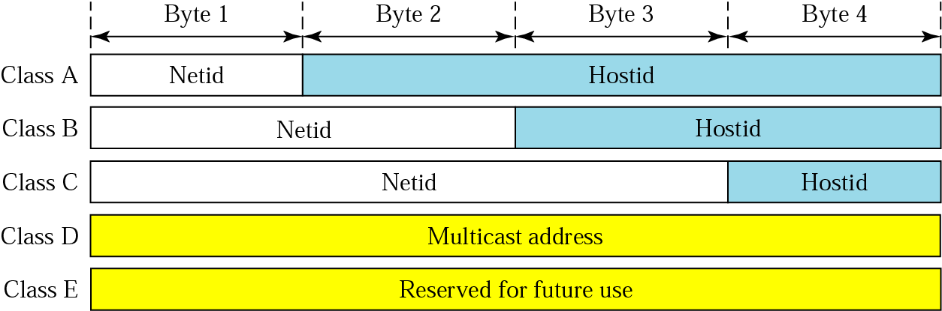
Class-based IP Addresses

Slide 18
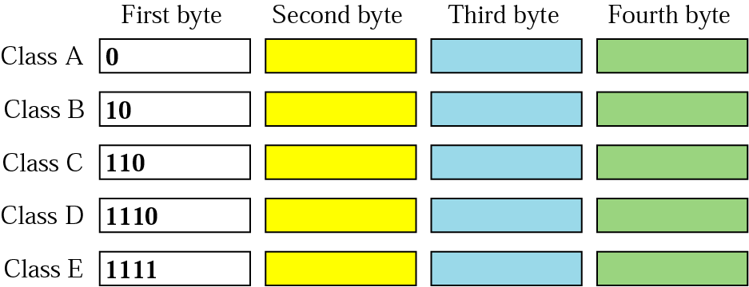
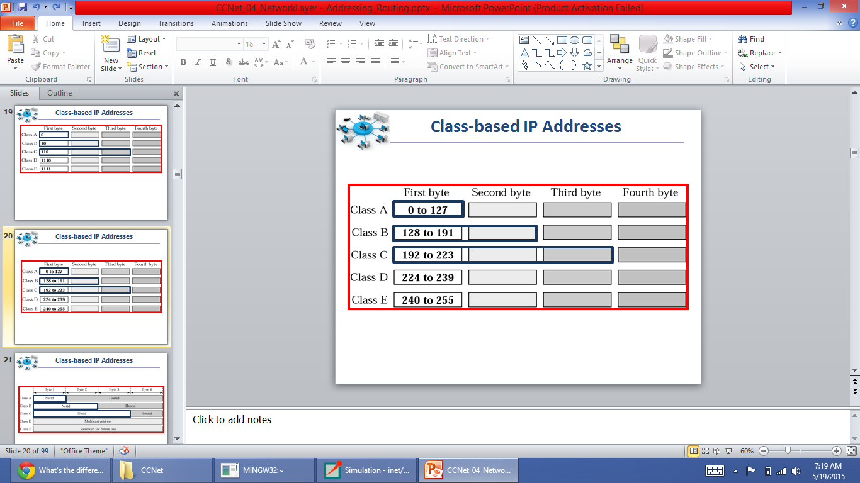
Class-based IP Addresses

Slide 19
Classless Addressing
Classless addressing also known as Class Inter-Domain Routing (CIDR) was introduced in 1993 to replace classful addressing. It allows the user to use VLSM or Variable Length Subnet Masks.
In CIDR subnet masks are denoted by /X. For example a subnet of 255.255.255.0 would be denoted by /24. To work a subnet mask in CIDR, we have to first convert each octet into its respective binary value.
Division of address (Subnet and Host instead of Network, Subnet, and Host)
无类寻址也称为类域间路由(CIDR)
它允许用户使用VLSM或可变长度子网掩码。

Slide 20
What is Subnetting and Supernetting?
网络位向主机位借位，使得网络部分的位数加长，产生子网

Slide 21
Subnetting
202.125.138.0/24
202.125.138.0 – 202.125.138.255
202.125.138.0/25
202.125.138.128/25
202.125.138.0 – 202.125.138.127
202.125.138.128 – 202.125.138.255
Borrowing one host bit provides two subnetworks

Slide 22
Subnetting
202.125.138.0/24
202.125.138.0 – 202.125.138.255
0000 0000
1100 0000
202.125.138.0/26
202.125.138.192/26
202.125.138.0 – 202.125.138.63
202.125.138.192 – 202.125.138.255
0100000
1000 0000
202.125.138.64/26
202.125.138.128/26
202.125.138.64 – 202.125.138.127
202.125.138.128 – 202.125.138.191
Borrowing two host bits provide four subnetworks

Slide 23
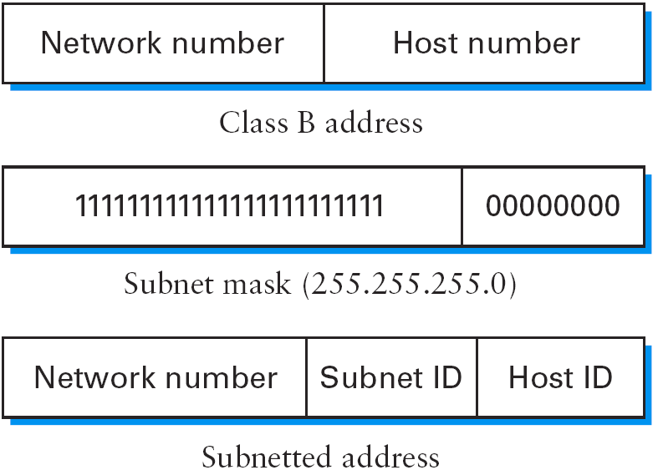
Subnetting – General Definition
一般来说，对于一个有m个可能主机的网络，借n位可以提供2^n个m/n个主机的子网络
In general, for a network with m possible hosts, borrowing n bits provides 2^{n} subnetworks of m/n hosts

Slide 24
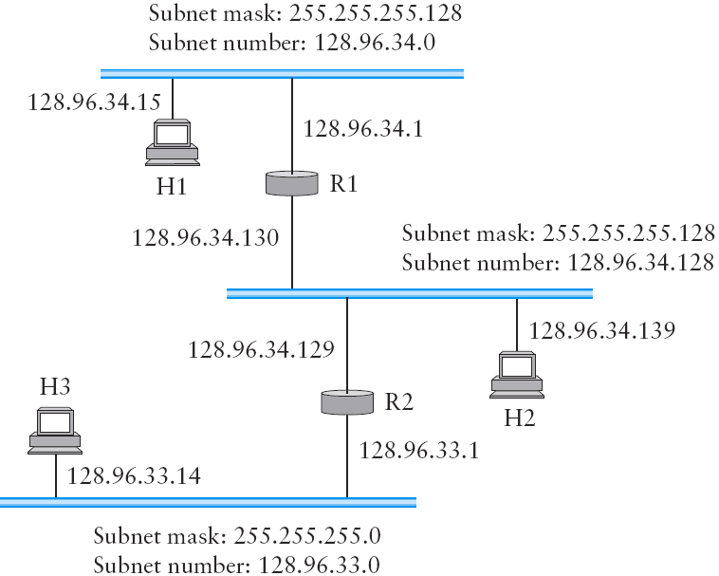
Subnetting – Example

Slide 25

Supernetting – Route Aggregation
202.125.138.0/26
202.125.138.64/26
202.125.138.0/24
is directly connected to me
202.125.138.0/26; 202.125.138.64/26; 202.125.138.128/26; 202.125.138.192/26
are directly connected to me
202.125.138.128/26
202.125.138.192/26
超网络有助于减少程序的大小表路由器必须存储
Supernetting helps reduce the size of routing tables routers have to store

Slide 26
Question
Suppose a network has a prefix 150.32.64.34/20. Determine the
Total number of hosts
Network/Subnet mask
Network/Subnet number
Broadcast address
Address of the first host
Address of the last host

Slide 27
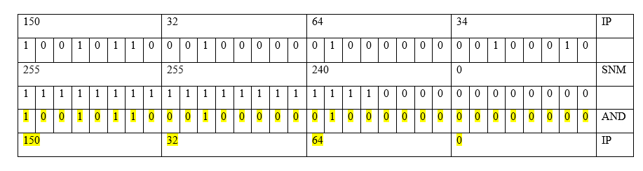
Question

Slide 28
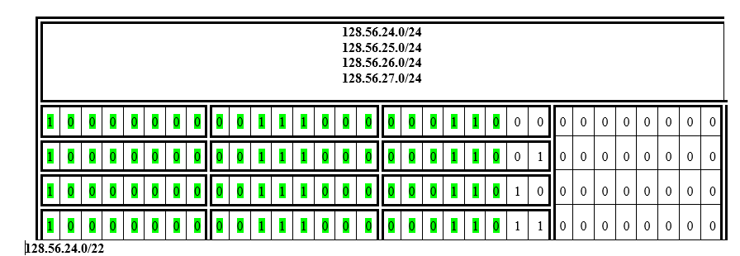
Route Aggregation Example

Slide 29
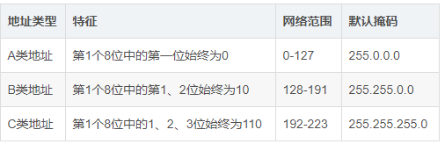
计算题
已知：172.16.30.10/20，请计算出这个IP地址的主机数，子网数，子网位，主机位，子网号，主机号，网络地址，广播地址，主机地址范围格式多少？
IP地址： 10101100.00010000.00011110.00001010（172.16.30.10）
IP类型为B 类，网络地址占了20位，子网掩码为：
11111111.11111111.11110000.00000000 （255.255.240.0）
网络地址=子网掩码 & IP地址
10101100.00010000.00010000.00000000（172.16.16.0）
子网网络位占4位（相较于默认掩码），子网数： 2^4 = 16
当前子网号：10101100.00010000.00011110.00001010
当前主机号：10101100.00010000.00011110.00001010
子网主机位占12位，主机数： 2^12 - 2 =4094
10101100.00010000.00010000.00000000
主机地址范围格式：172.16.16.1 ~ 172.16.31.254
127.16.31.255 为广播地址
127.16.16.0 为网络地址

Slide 30
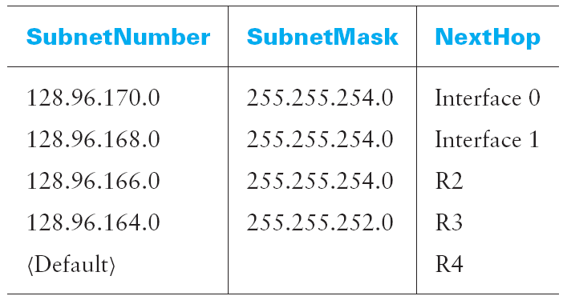
Question
Suppose a router has built up the routing table shown in Table. The router can deliver packets directly over interfaces 0 and 1, or it can forward packets to routers R2, R3, or R4. Assume the router does the longest prefix match. Describe
what the router does with a packet addressed to each of the following destinations:
(a) 128.96.171.92
(b) 128.96.167.151
(c) 128.96.163.151
(d) 128.96.169.192

